Slide 1
What is AI

Slide 2
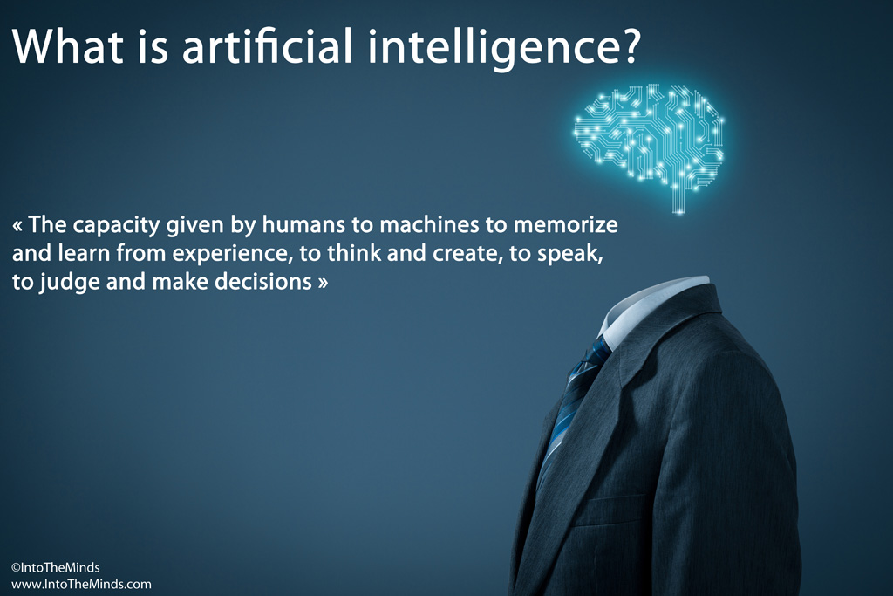

Slide 3
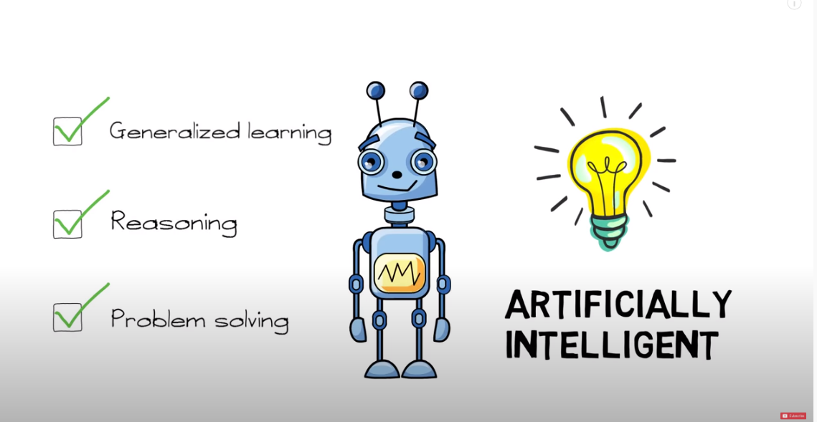
https://www.youtube.com/watch?v=ad79nYk2keg

Slide 4
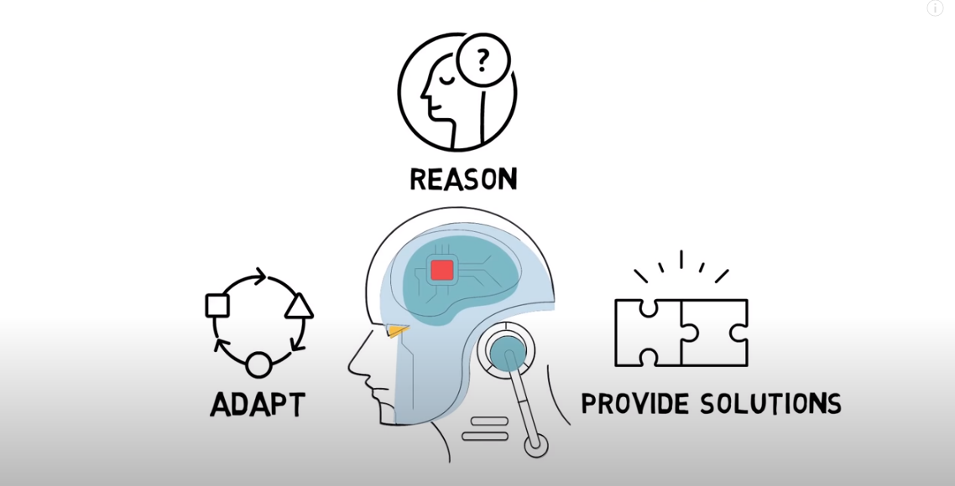
https://www.youtube.com/watch?v=ad79nYk2keg

Slide 5
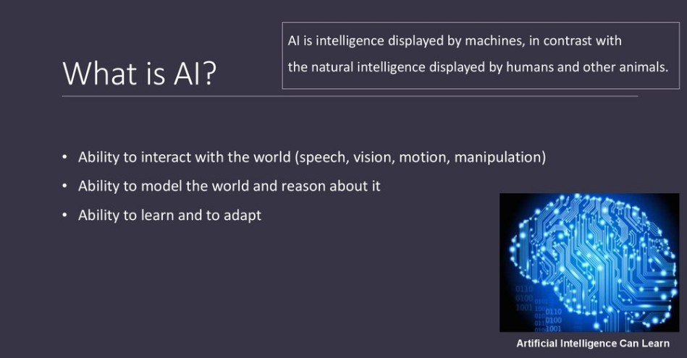

Slide 6
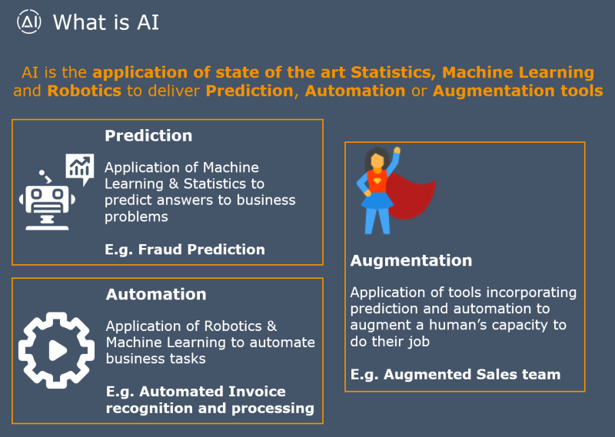

Slide 7
AI, Machine learning, Deep learning

Slide 8
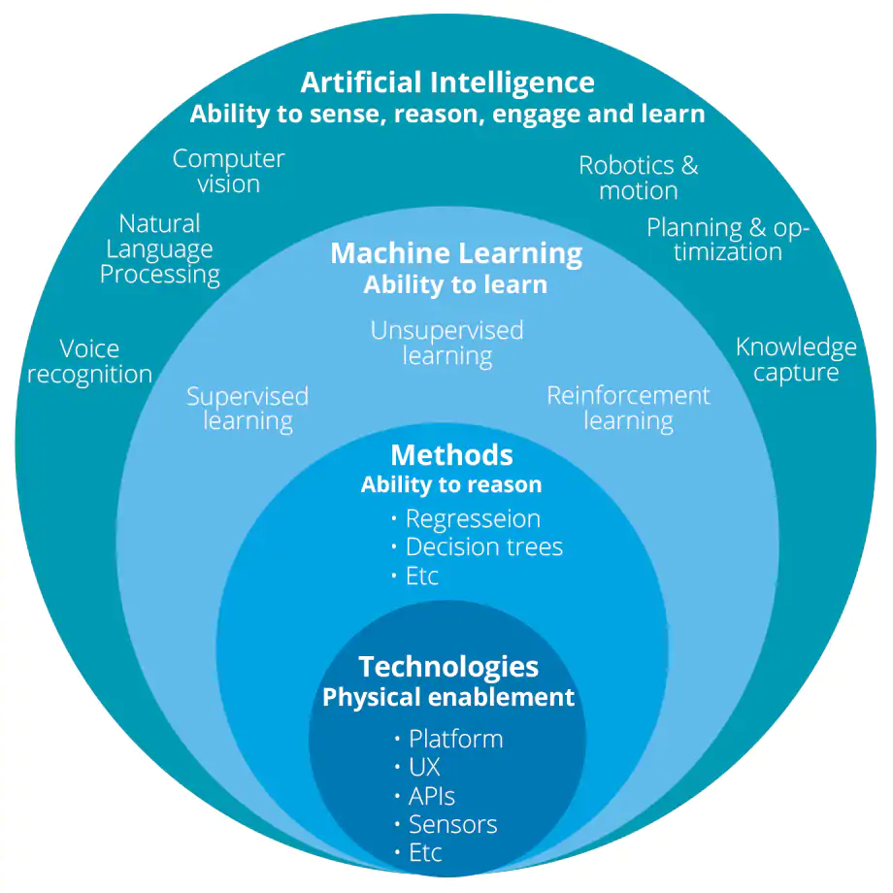

Slide 9
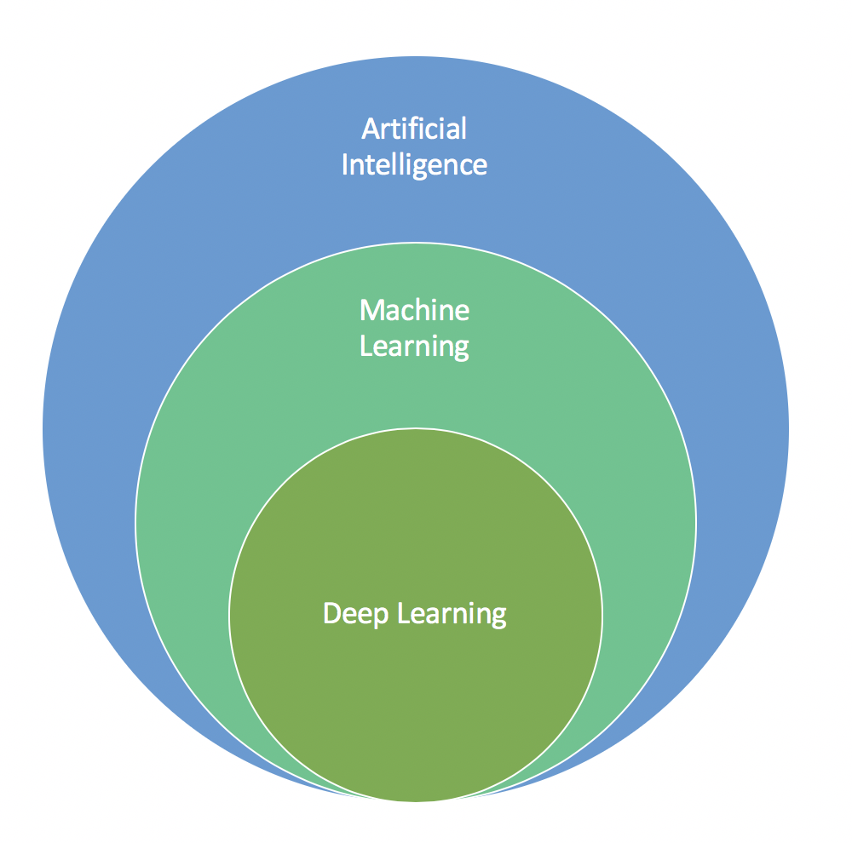
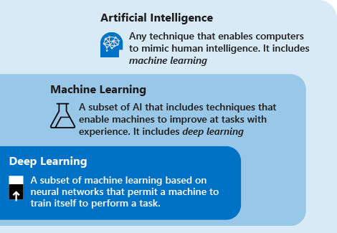
https://docs.microsoft.com/en-us/azure/machine-learning/concept-deep-learning-vs-machine-learning

Slide 10
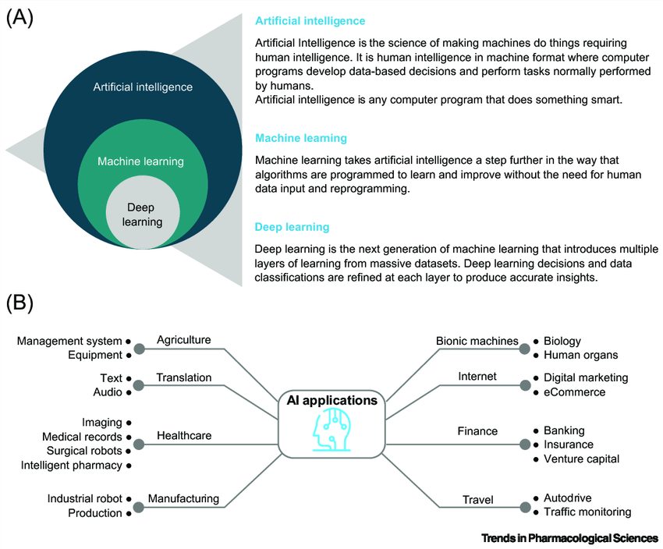
https://www.researchgate.net/publication/334475203_Advancing_Drug_Discovery_via_Artificial_Intelligence

Slide 11
Big Data

Slide 12
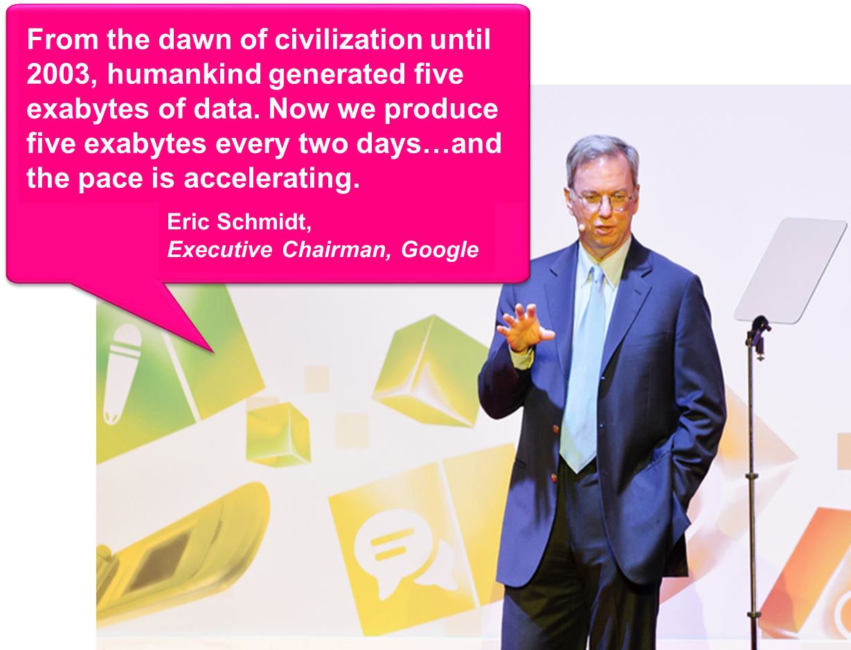

Slide 13
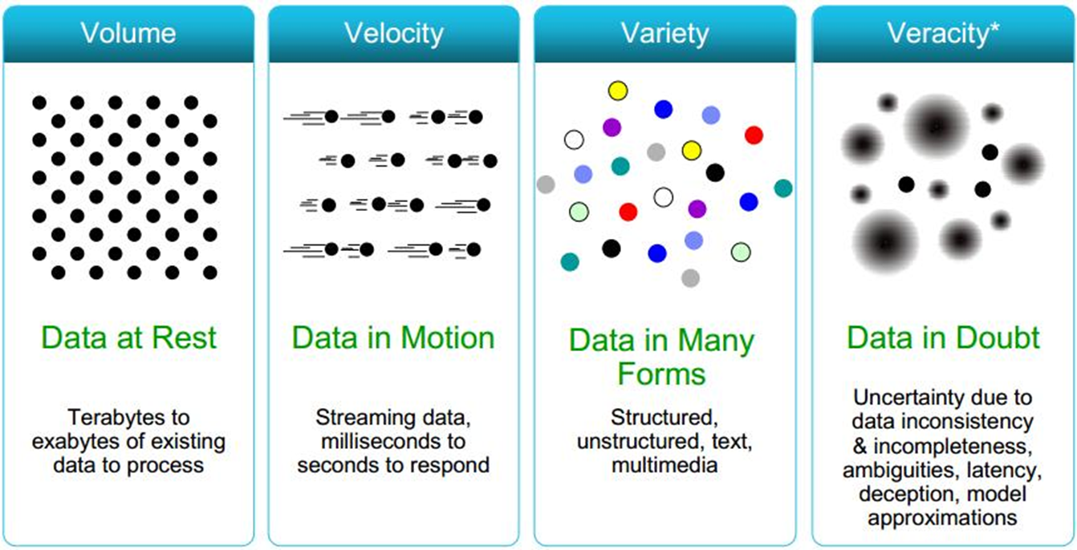
The four Vs in Big Data

Slide 14
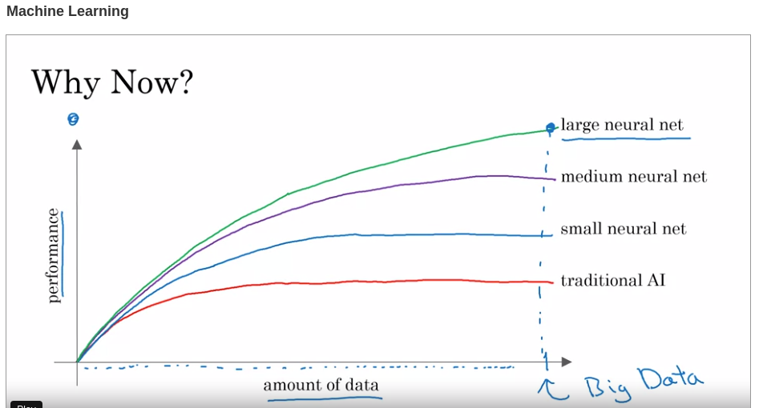
“Why is Big Data relevant to take the most of AI?” or is it “Why is AI relevant to take the most of Big Data?”

Slide 15
Types of AI

Slide 16
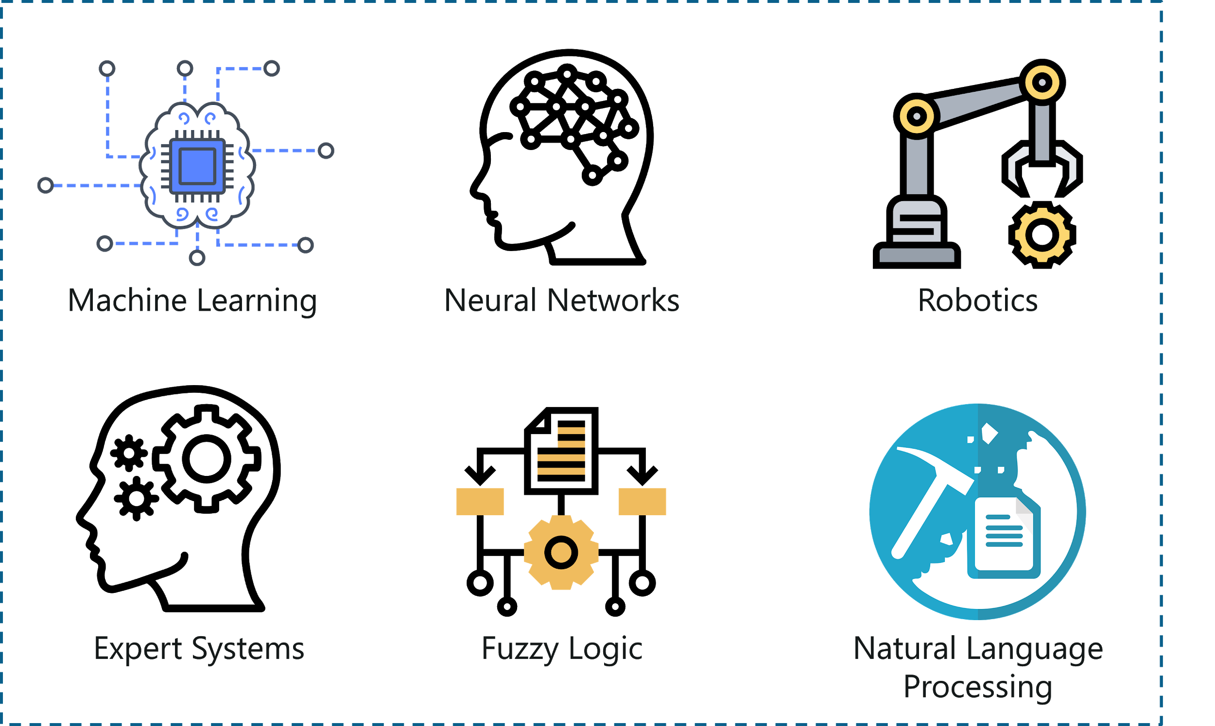
https://www.edureka.co/blog/types-of-artificial-intelligence/

Slide 17
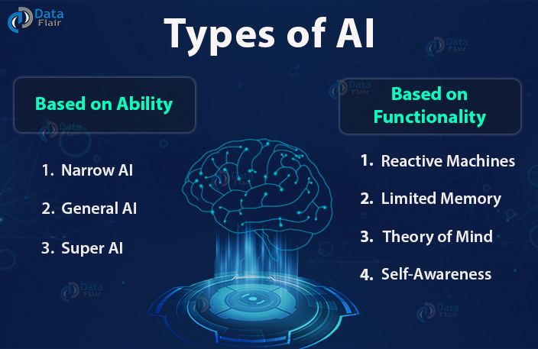
https://data-flair.training/blogs/ai-and-machine-learning/

Slide 18
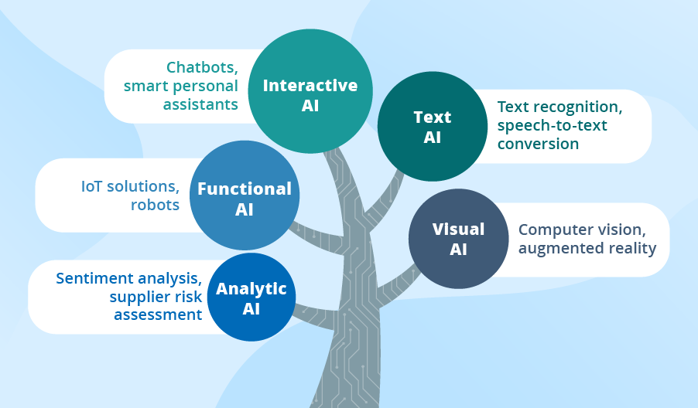
https://www.scnsoft.com/blog/artificial-intelligence-types

Slide 19
AI applications in healthcare

Slide 20
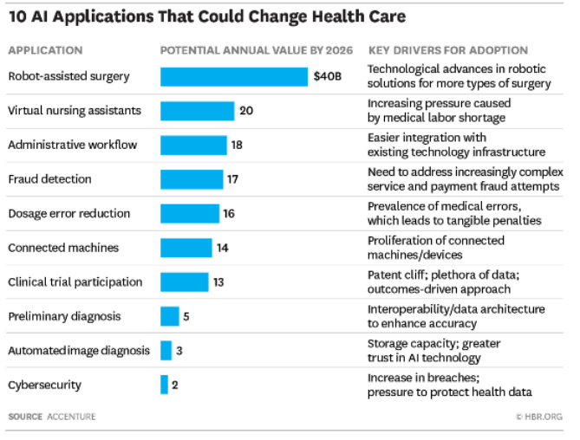
Source: Harvard Business Review: https://www.investkl.gov.my/assets/multimediaMS/file/10-Promising-AI-Applications-in-HealthCare.PDF

Slide 21
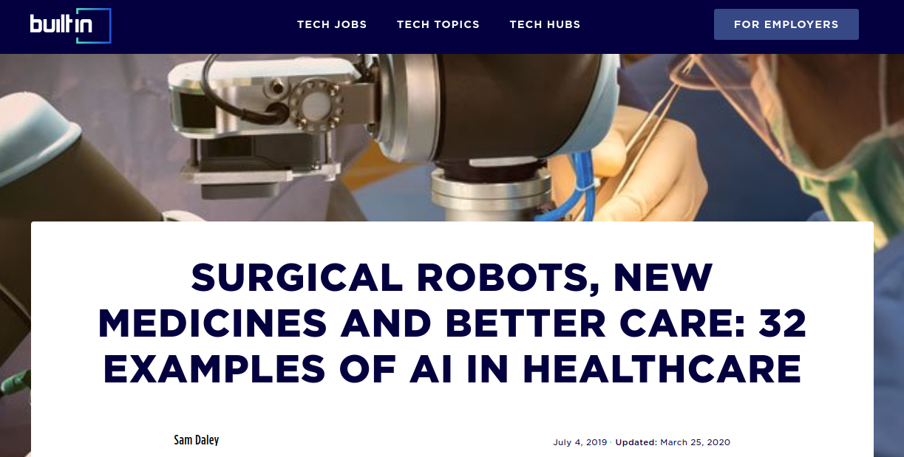
https://builtin.com/artificial-intelligence/artificial-intelligence-healthcare

